Slide 1


SP3176 The Universe Chapter 3: Light and Atoms
Lim Zhi Han

Slide 2
Learning Objectives
By the end of this chapter, you should be familiar with the concepts of light and quantum mechanics, the history of the various atomic models proposed and the reasons propelling them. You will also be introduced to the field of spectroscopy as means to study light and atoms together. Finally, a mention about the modern interpretation of quantum mechanics with wavefunctions and probabilities is made.

Slide 3
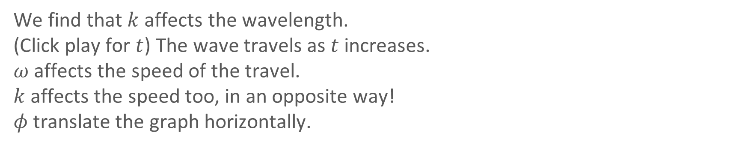
Mathy stuff (pre-lesson homework)
Graph $y=A\sin{(kx+ωt+φ)}$ on Desmos.
We find that $k$ affects the wavelength.
(Click play for $t$) The wave travels as $t$ increases.
$ω$ affects the speed of the travel.
$k$ affects the speed too, in an opposite way!
$φ$ translate the graph horizontally.
$$e^{i\left(kx−ωt\right)}=\cos{(kx−ωt)}−i\sin{(kx−ωt)}$$

Slide 4
Light

Slide 5
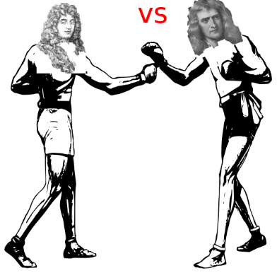
Light is a wave
Christian Huygens described light as a wave propagating with high but finite speed in Traite de la Lumiere (1690).
Newton advocated that light are particles.
Newton won... But..
FJGAR, CC BY-SA 4.0, via Wikimedia Commons
In 1801, Thomas Young proved that light is indeed a wave.
How did he do that?

Slide 6
Waves
Imagine throwing a stone into water, producing water waves
Visually we see:
coming out from all directions from the source.
Wavefronts
(showing the maximums)

Slide 7
Wavefronts
Circular wavefronts
(point source)
Plane wavefronts
(faraway source)

Slide 8
Diffraction
When a plane wave goes through a small hole:

Slide 9
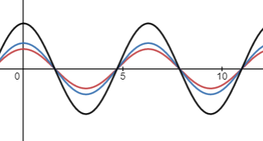
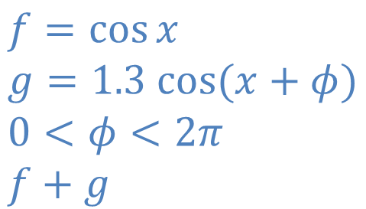
Superposition of waves
Type in Desmos
$$f=\cos{x} \\ g=1.3 cos{(x+φ)} \\ 0<φ<2π \\ f+g$$

Slide 10
Superposition of waves
+
Diffraction
= ?

Slide 11


Max
When a plane wave goes through 2 small holes:
Min
Max
Min
Diffraction pattern
Max
Min
Max
Min
Max
Notes:
Show ripple tank
youtube.com/watch?v=S2XTlczcWag
https://www.youtube.com/watch?v=O81Cilon10M

Slide 12

Activity 1: Water waves and Interference patterns

Slide 13
Max
When a plane wave goes through 2 small holes:
Min
Max
Min
Diffraction pattern
Max
Min
Max
Min
Max
Notes:
Show ripple tank
youtube.com/watch?v=S2XTlczcWag
https://www.youtube.com/watch?v=O81Cilon10M

Slide 14
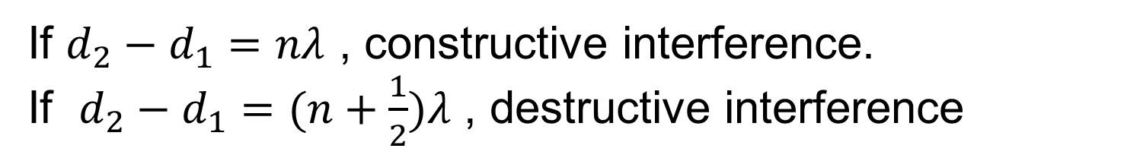
If $d_{2}−d_{1}=nλ$ , constructive interference. If $d_{2}−d_{1}=(n+\frac{1}{2})λ$ , destructive interference

Slide 15
Activity 2: Diffraction patterns DIY
Create your own diffraction patterns using slits and (laser) light source.
Note down any notable observations.

Slide 16
Ex. What if we replace the red laser with a green laser?
What if we use a white light instead of laser?

Slide 17
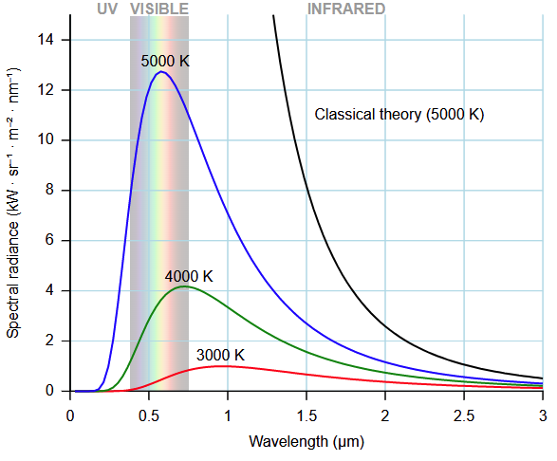
Light are Particles (1905, Max Planck, Albert Einstein)
Treating light as particles (5000K)
Treating light as waves (5000K)
Spectra of light from (hot) objects
Image credit: D. Kule, PD

Slide 18
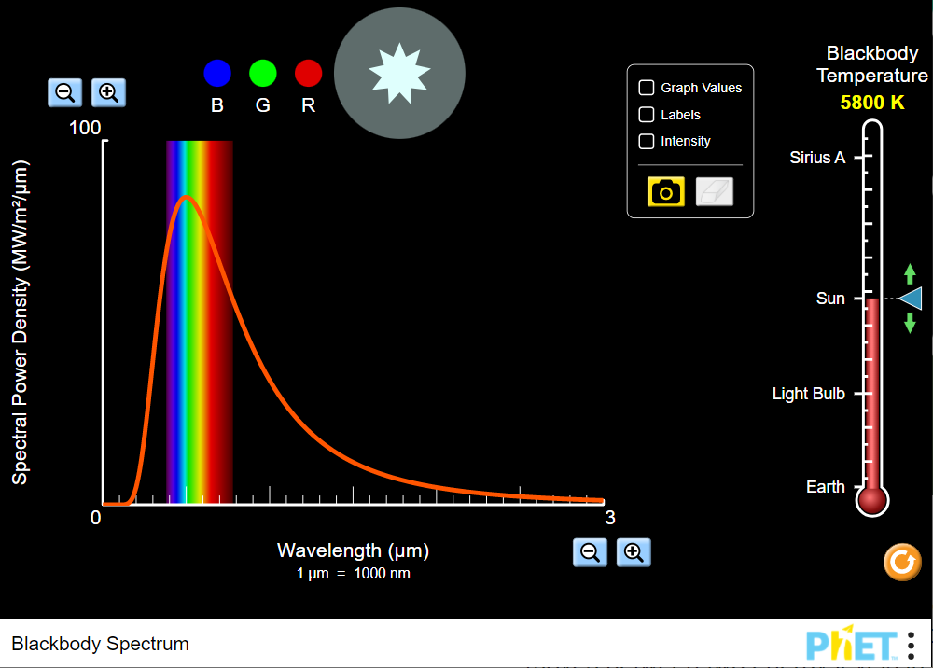

Blackbody Radiation
Sodium a
Distribution of light emitted by an object with a non-zero temperature.
Play with this simulation!
https://phet.colorado.edu/sims/html/blackbody-spectrum/latest/blackbody-spectrum_en.html

Slide 19
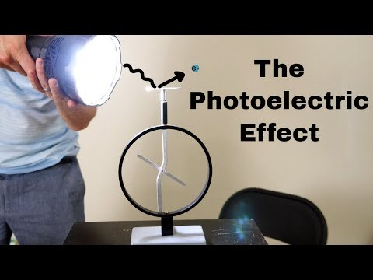
Light are Particles (1905, Max Planck, Albert Einstein)

Slide 20
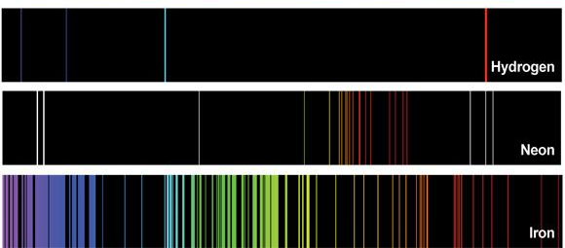
Atomic Spectra (Emission)
Image credit: University of Hawaii

Slide 21


Different kinds of light emission
Emission from atomic discharge (lamps)
Blackbody emission due to temperature of object
Discrete lines
Continuous band
Dilute gas. Little or no interaction between particles.
Collective effect of many particles that interact
Depends on type of particle
Only depends on temperature
https://phet.colorado.edu/sims/html/blackbody-spectrum/latest/blackbody-spectrum_en.html

Slide 22
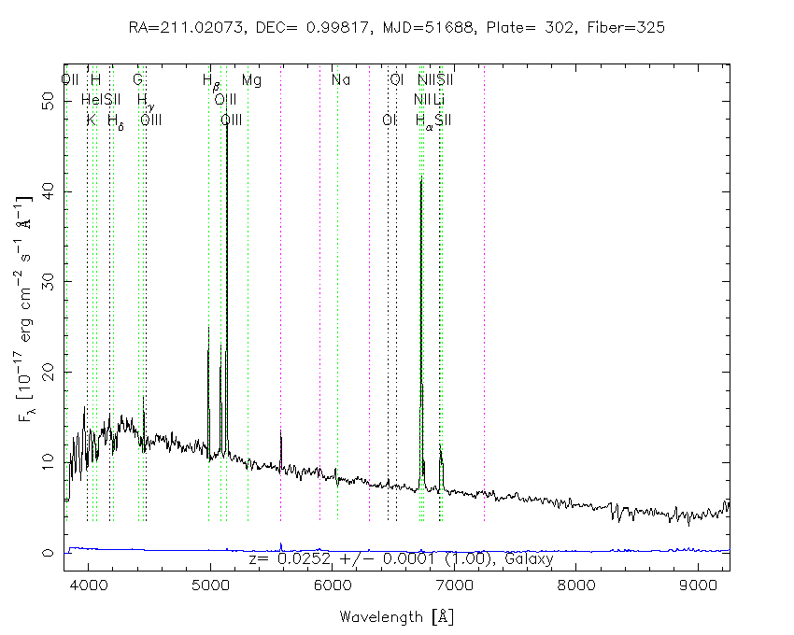
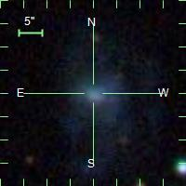
Sodium a
Spectrum of a galaxy# showing both continuous blackbody and discreet atomic emission peaks
# SDSS object 582093484903825431
Image credit: SDSS

Slide 23
Atomic Spectra: Emission vs Absorption
Emission
Relaxation of excited energy states by releasing photons
Absorption
Excitation of energy states by absorbing photons from background light source.

Slide 24
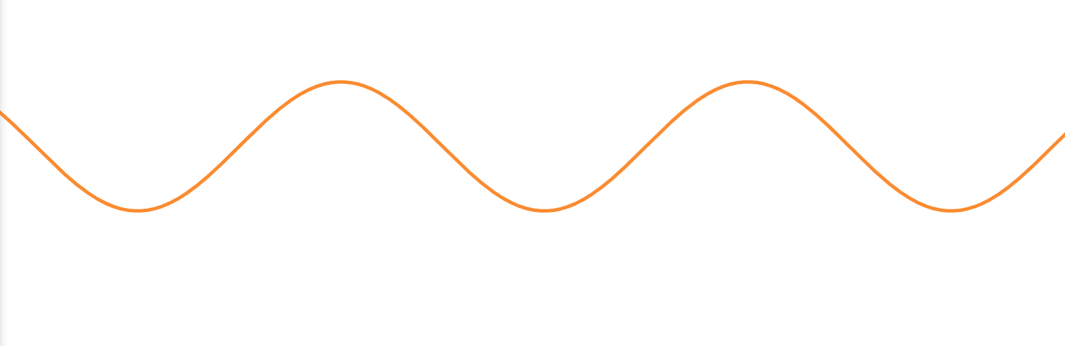
Atomic Spectra (Absorption)
Cooler atmosphere
Atoms in the cooler atmosphere absorbs photons of certain energies to excite to higher energy states.
Hot interior

Slide 25
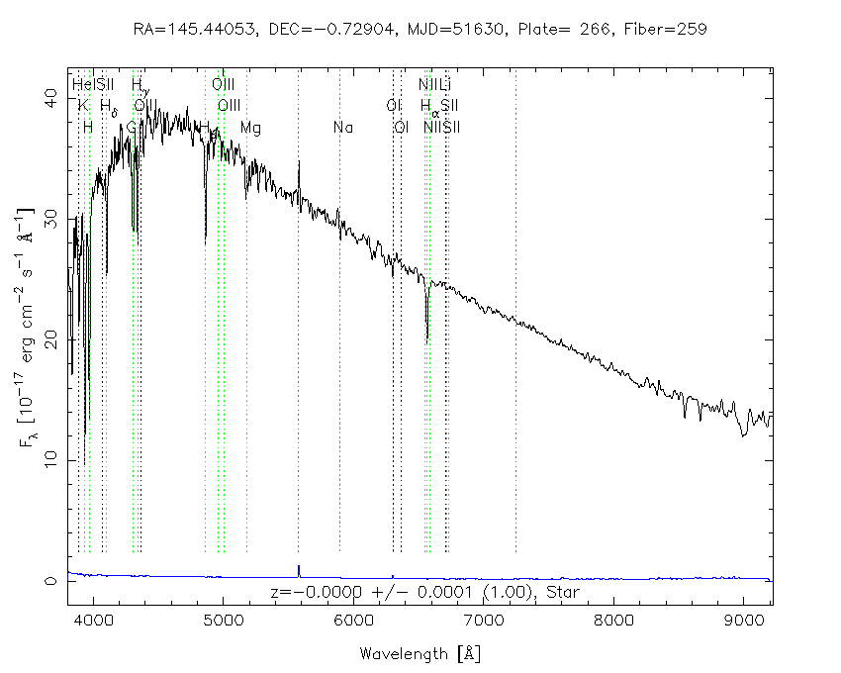
Spectrum of a star# showing both continuous blackbody and discreet atomic absorption peaks
# SDSS object 75094094052851712
Image credit: SDSS

Slide 26


Spectrometer

Slide 27
Atoms
Atoms
Atoms
Atoms
Atoms
Atoms
Atoms
Atoms
Atoms
Atoms
Atoms
Atoms
Atoms
Atoms
Atoms
Atoms
Atoms
Atoms
Atoms
Atoms
Atoms
Atoms
Atoms
Atoms
Atoms

Slide 28
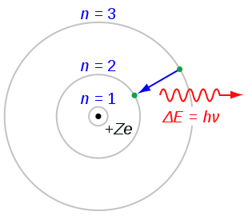
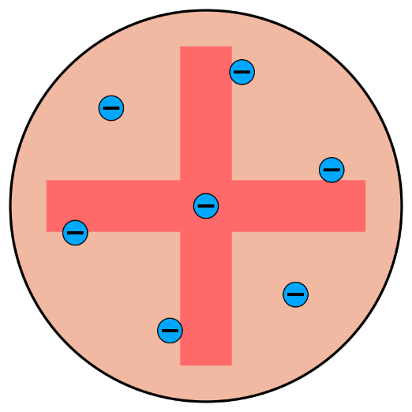
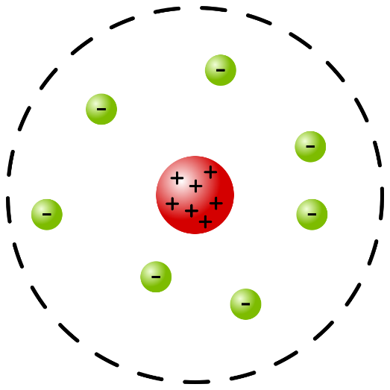
Atomic models
J. J. Thompson (1904)
E. Rutherford (1911)
N. Bohr (1913)
Kurzon, CC BY-SA 4.0, via Wikimedia Commons
Bensteele1995, CC BY-SA 3.0, via Wikimedia Commons
JabberWok, CC BY-SA 3.0, via Wikimedia Commons

Slide 29



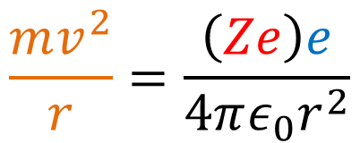

Bohr’s atomic model
Postulate 1: Electrons move in circular orbits around the nucleus.
-
$$\frac{mv^{2}}{r}=\frac{\left(Ze\right)e}{4πε_{0}r^{2}}$$
Derivation of centripetal acceleration
+
$$v^{2}=ω^{2}r^{2}$$
Centripetal force
Centripetal acceleration
= Mass x
Image credit: Dbachman, CC-BY-SA-3.0

Slide 30

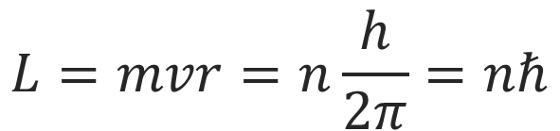
Bohr’s atomic model
Postulate 2: The angular momentum of the electron is quantised
$$L=mvr=n\frac{h}{2π}=nℏ$$

Slide 31
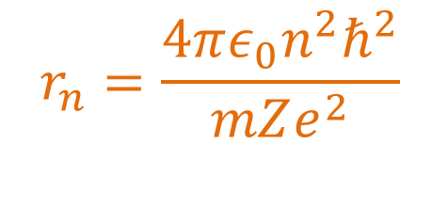
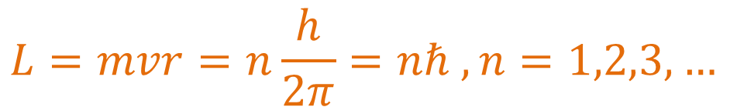
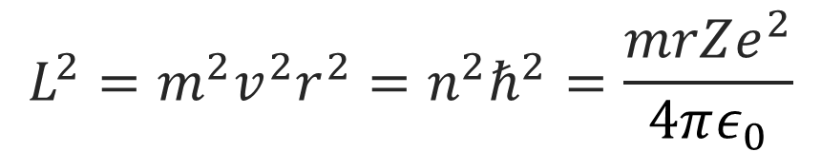
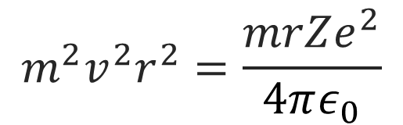
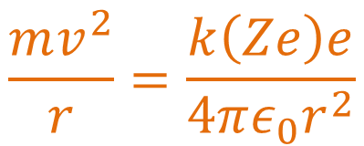
Bohr’s atomic model
$$\frac{mv^{2}}{r}=\frac{k\left(Ze\right)e}{4πε_{0}r^{2}}$$
$$L=mvr=n\frac{h}{2π}=nℏ , n=1,2,3,…$$
P1:
P2:
$$m^{2}v^{2}r^{2}=\frac{mrZe^{2}}{4πε_{0}}$$
$${L^{2}=m}^{2}v^{2}r^{2}=n^{2}ℏ^{2}=\frac{mrZe^{2}}{4πε_{0}}$$
$$r_{n}=\frac{4πε_{0}n^{2}ℏ^{2}}{mZe^{2}}$$
The radii of the circular orbits are quantized!
Setting $n=1$ and $Z=1$ allows us to estimate the size of a hydrogen atom.

Slide 32
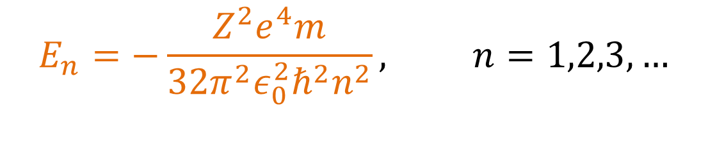
Bohr’s atomic model
Energy of electron in quantised orbits:
$$E_{n}=−\frac{Z^{2}e^{4}m}{32π^{2}ε_{0}^{2}ℏ^{2}n^{2}}, n=1,2,3,…$$
Derivation in lecture notes (pg 17)

Slide 33
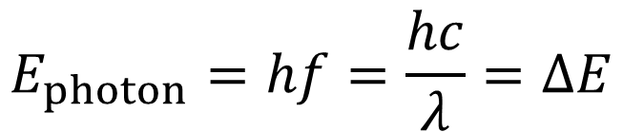
Bohr’s atomic model
Postulate 3: Electrons can transit between allowed orbits by emitting or absorbing of a photon.
The energy of the photon emitted/absorbed is equal to the energy difference between the orbits.

Slide 34
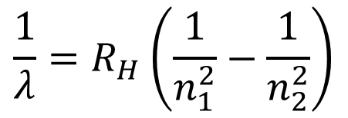
In 1888, Johannes Rydberg examine the wavelengths of spectral lines carefully
Wavelengths of spectral lines observed for Hydrogen
Lyman series | Balmer series | Paschen series
122 nm | 656 nm | 1875 nm
103 nm | 486 nm | 1282 nm
97 nm | 434 nm | 1094 nm
95 nm | 410 nm
Balmer series:
He found an equation that can derive all the above numbers!

Slide 35
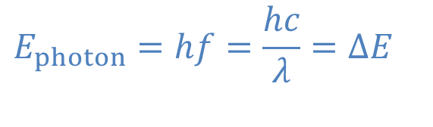
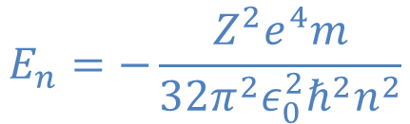
Ex. In 1888, Johannes Rydberg wrote down an equation to describe spectral lines:
Where $R_{H}$ is a constant. Derive the Rydberg formula using Bohr’s model.
From Bohr’s model,
$$E_{n}=−\frac{Z^{2}e^{4}m}{32π^{2}ε_{0}^{2}ℏ^{2}n^{2}}$$
$$E_{photon}=hf=\frac{hc}{λ}=ΔE$$

Slide 36
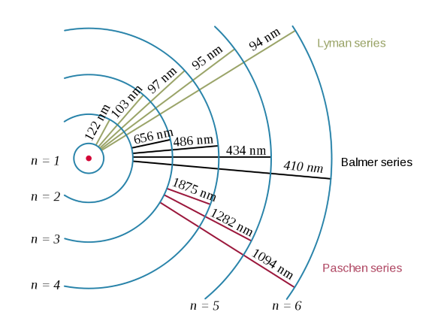
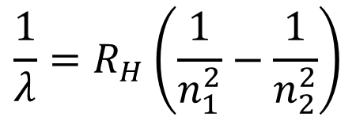
Bohr’s atomic model

Slide 37
***End of week 3 lecture***

Slide 38
Recall Bohr’s atomic model

Slide 39
Atomic Spectra (Emission)
Image credit: University of Hawaii

Slide 40
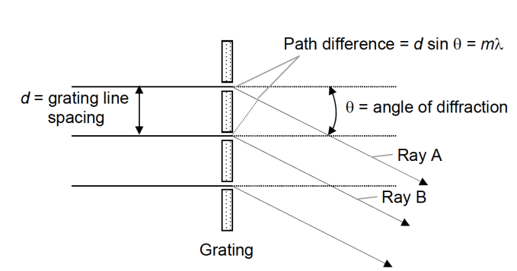
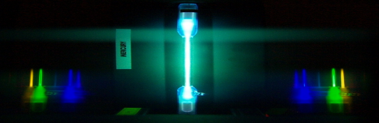
Atomic Spectrum Experiment
25% of the grade :)
Part 1
Understand the principles of a spectrometer
Record and identify different atomic spectrums
Part 2

Slide 41
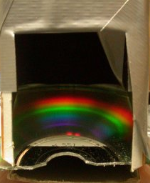

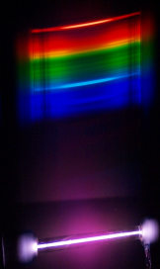
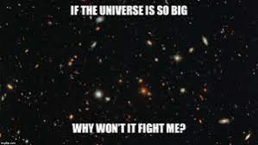
Atomic Spectrum Experiment
25% of the grade :)
Part 2
Build your own spectrometer
Record and Analyze different atomic spectra
TEST YOUR MIGHT

Slide 42
See you again in week 4...

